Slide 1
Tensorizing Deep Learning
Hrriday Viraj Ruparel
CS 618 – Theoretical Foundations of Machine Learning
IIT Gandhinagar
Date: 20th Nov 2024

Slide 2
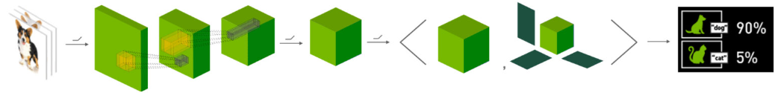
Problem Statement
Want to analyze how Tensors Operations and Tensor Decompositions contribute to the field of Deep Learning.
Will be looking at: Tensor-based compression of deep neural networks
Based on applications, will also introduce some common techniques of Tensor Decomposition
[Sun-Hao-Li; Img Src: NVIDIA Research: Tensors Are the Future of Deep Learning]

Slide 3
Compressing Deep Neural Networks

Slide 4

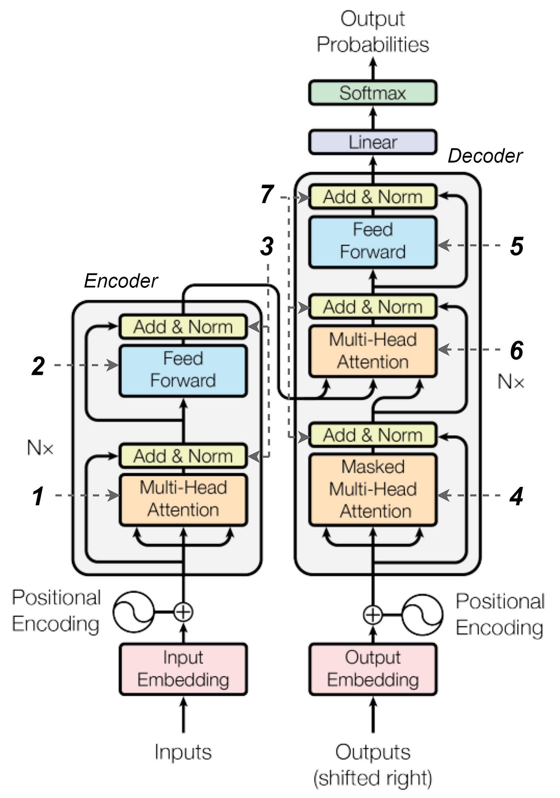
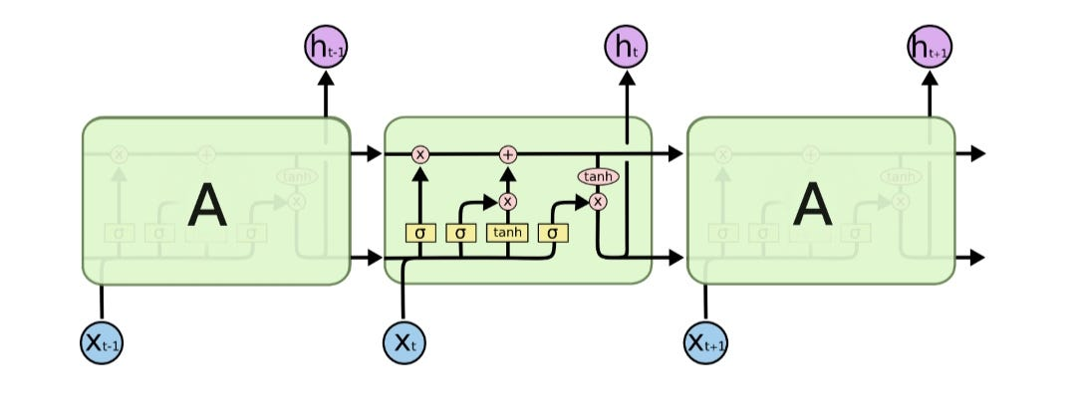
Compressing Deep Neural Networks
Motivation: Deep Neural Nets like CNNs are go-to architectures for image-specific tasks. BUT:
They are expensive to train (both in time and memory)
They are heavy models with millions of parameters
They cannot be deployed on mobile devices
Hence, compressing CNNs is the need of the hour!
Not only an issue with CNNs, but with other architectures as well. Ex: RNNs, LSTMs, GNNs, Transformers, etc.
[Sun-Hao-Li]

Slide 5
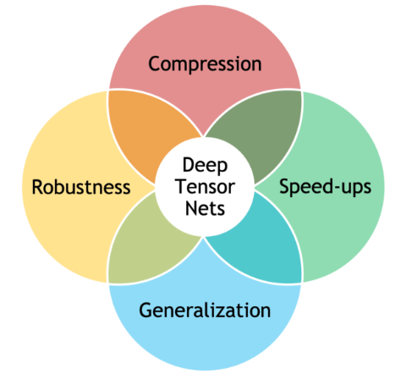
Compressing Deep Neural Networks
Solution: Tensor-based Compression of Deep Neural Networks:
Better performance and generalization
Improved robustness, from implicit (low-rank structure) or explicit (tensor dropout) regularization
Parsimonious models, with a large reduction in the number of parameters
Computational speed-ups by operating directly and efficiently on factorized tensors
[NVIDIA Research: Tensors Are the Future of Deep Learning ]

Slide 6
Compressing Large Weight Matrices

Slide 7
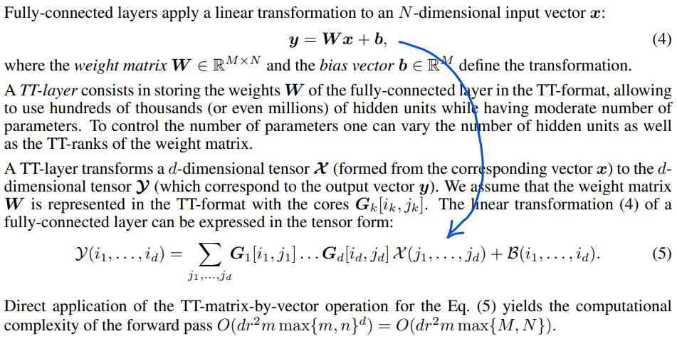
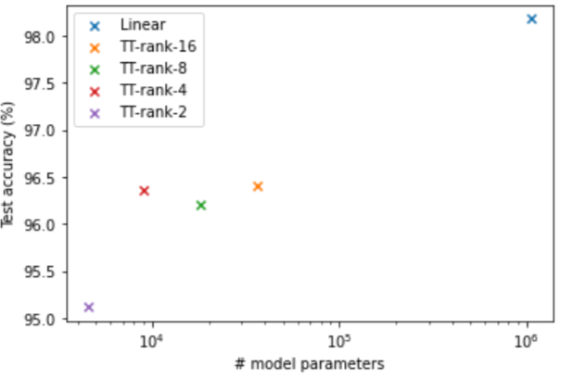
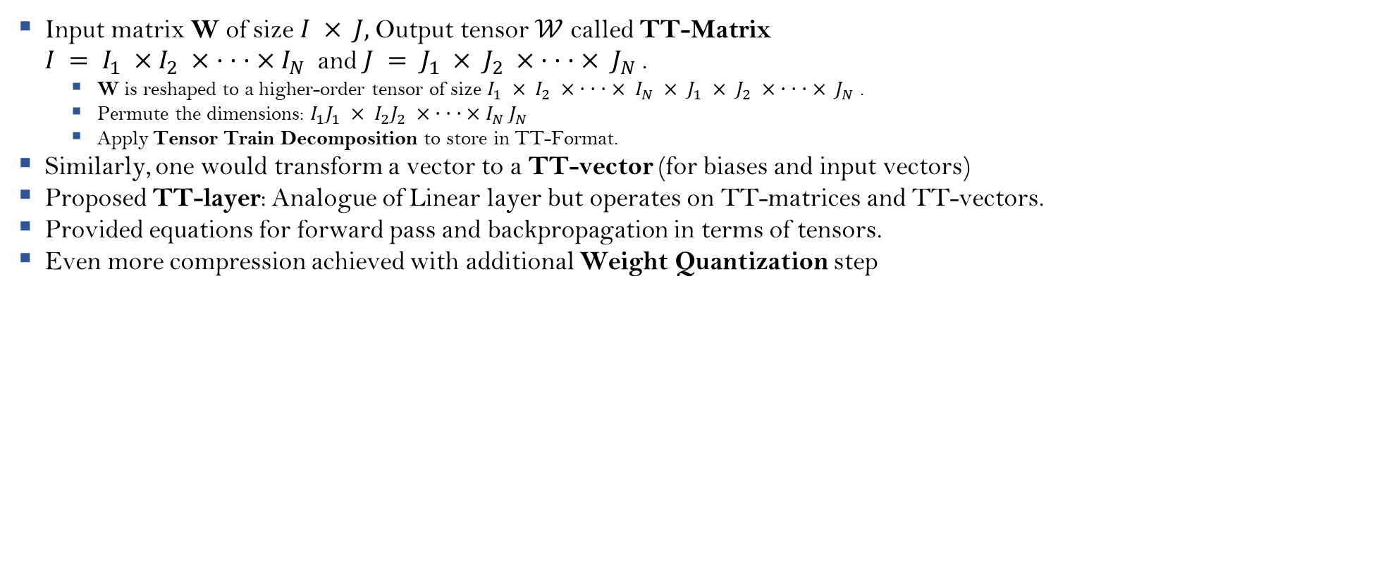
Compressing Large Weight Matrices
Input matrix W of size $I × J$, Output tensor $𝒲$ called TT-Matrix $I = I_{1} ×I_{2} × · · · ×I_{N}$ and $J = J_{1} × J_{2} × · · · × J_{N}$.
W is reshaped to a higher-order tensor of size $I_{1} × I_{2} × · · · × I_{N} × J_{1} × J_{2} × · · · × J_{N}$.
Permute the dimensions: $I_{1}J_{1} × I_{2}J_{2} × · · · ×I_{N} J_{N}$
Apply Tensor Train Decomposition to store in TT-Format.
Similarly, one would transform a vector to a TT-vector (for biases and input vectors)
Proposed TT-layer: Analogue of Linear layer but operates on TT-matrices and TT-vectors.
Provided equations for forward pass and backpropagation in terms of tensors.
Even more compression achieved with additional Weight Quantization step
[Panagakis-Koissafi-et al.; Novikov-Podoprikhin-et al.; tt-compression.ipynb]

Slide 8
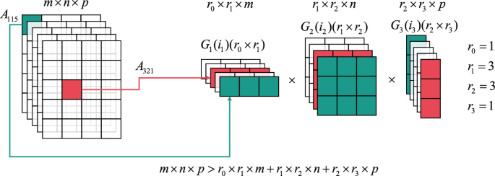
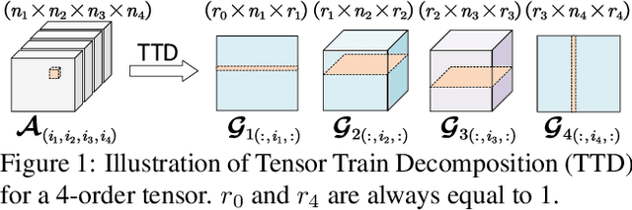
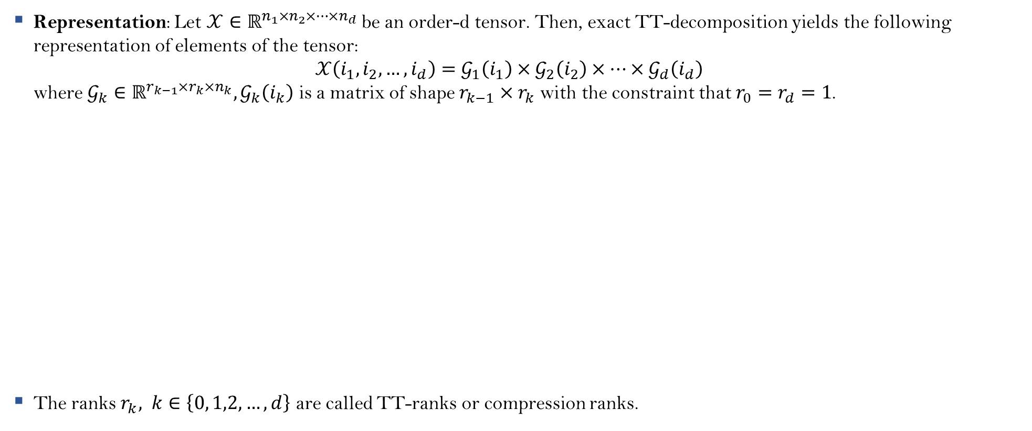
Tensor-Train Decomposition (TT)
Representation: Let $𝒳{∈ℝ}^{n_{1}×n_{2}×…×n_{d}}$ be an order-d tensor. Then, exact TT-decomposition yields the following representation of elements of the tensor: $𝒳\left(i_{1}, i_{2},…, i_{d}\right)=𝒢_{1}\left(i_{1}\right)×𝒢_{2}\left(i_{2}\right)×…×𝒢_{d}\left(i_{d}\right)$ where $𝒢_{k}∈ℝ^{r_{k−1}{×r}_{k}×n_{k}}, 𝒢_{k}\left(i_{k}\right)$ is a matrix of shape $r_{k−1}×r_{k}$ with the constraint that $r_{0}=r_{d}=1$.
The ranks $r_{k}, k∈\left\{0, 1,2, …, d\right\}$ are called TT-ranks or compression ranks.
[Oseledets]

Slide 9




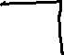
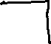

TT – SVD
[Oseledets]

Slide 10
Compressing CNNs

Slide 11
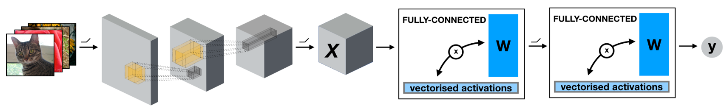
Compressing CNNs
Tensorization can be applied at multiple locations in CNNs:
Tensorizing Convolution Operation in Convolutional Layers
Tensorizing Contraction Layers (layers that transforms activation maps of convolutional layers to inputs of linear layers)
Tensorizing Fully-Connected Linear Layers (Compressing Large Weight Matrices)
Tensorizing Regression Layer (at the output)
[Panagakis-Koissafi-et al.]

Slide 12
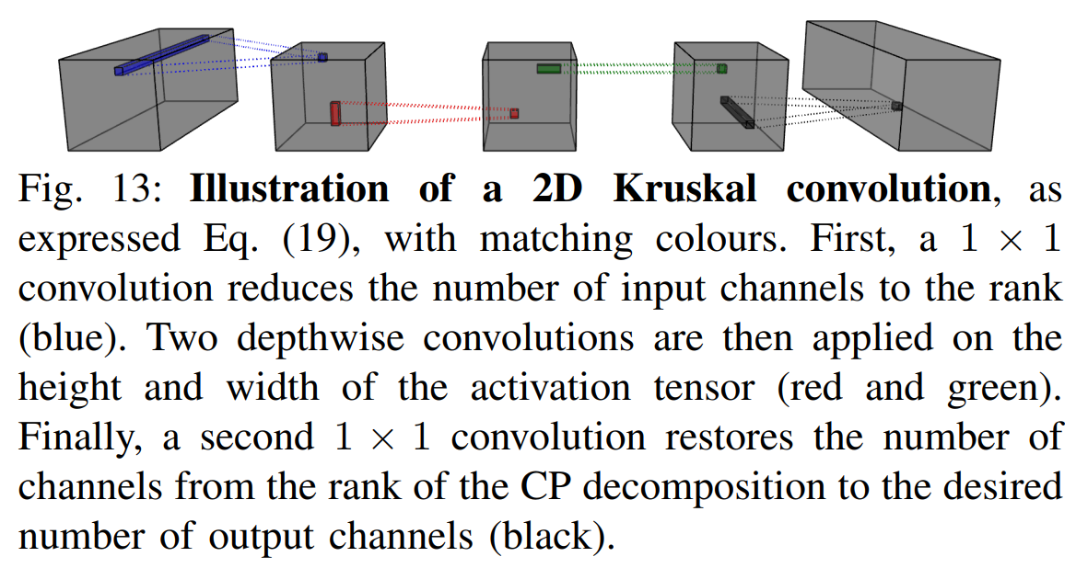
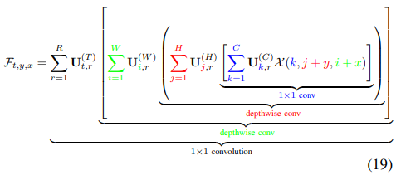
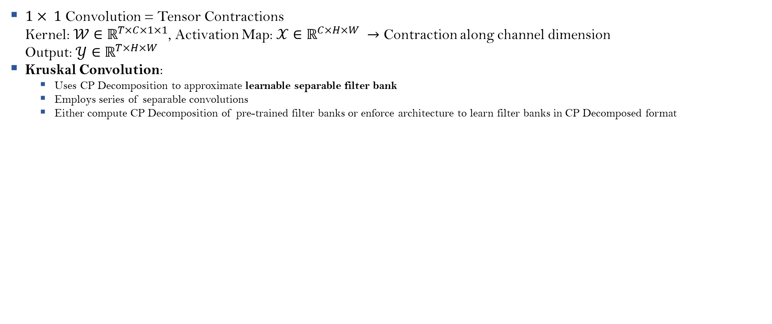
Tensorizing Convolution Operation
$1× 1$ Convolution = Tensor Contractions Kernel: $𝒲∈ℝ^{T×C×1×1}$, Activation Map: $𝒳∈ℝ^{C×H×W} →$ Contraction along channel dimension Output: $𝒴∈ℝ^{T×H×W}$
Kruskal Convolution:
Uses CP Decomposition to approximate learnable separable filter bank
Employs series of separable convolutions
Either compute CP Decomposition of pre-trained filter banks or enforce architecture to learn filter banks in CP Decomposed format
[Lebedev-Ganin-et al.; Panagakis-Koissafi-et al.]

Slide 13
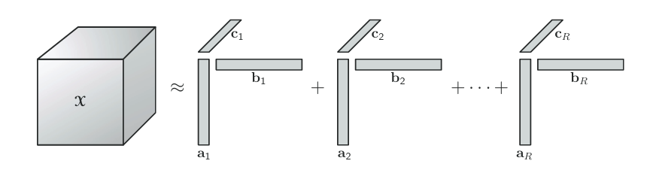
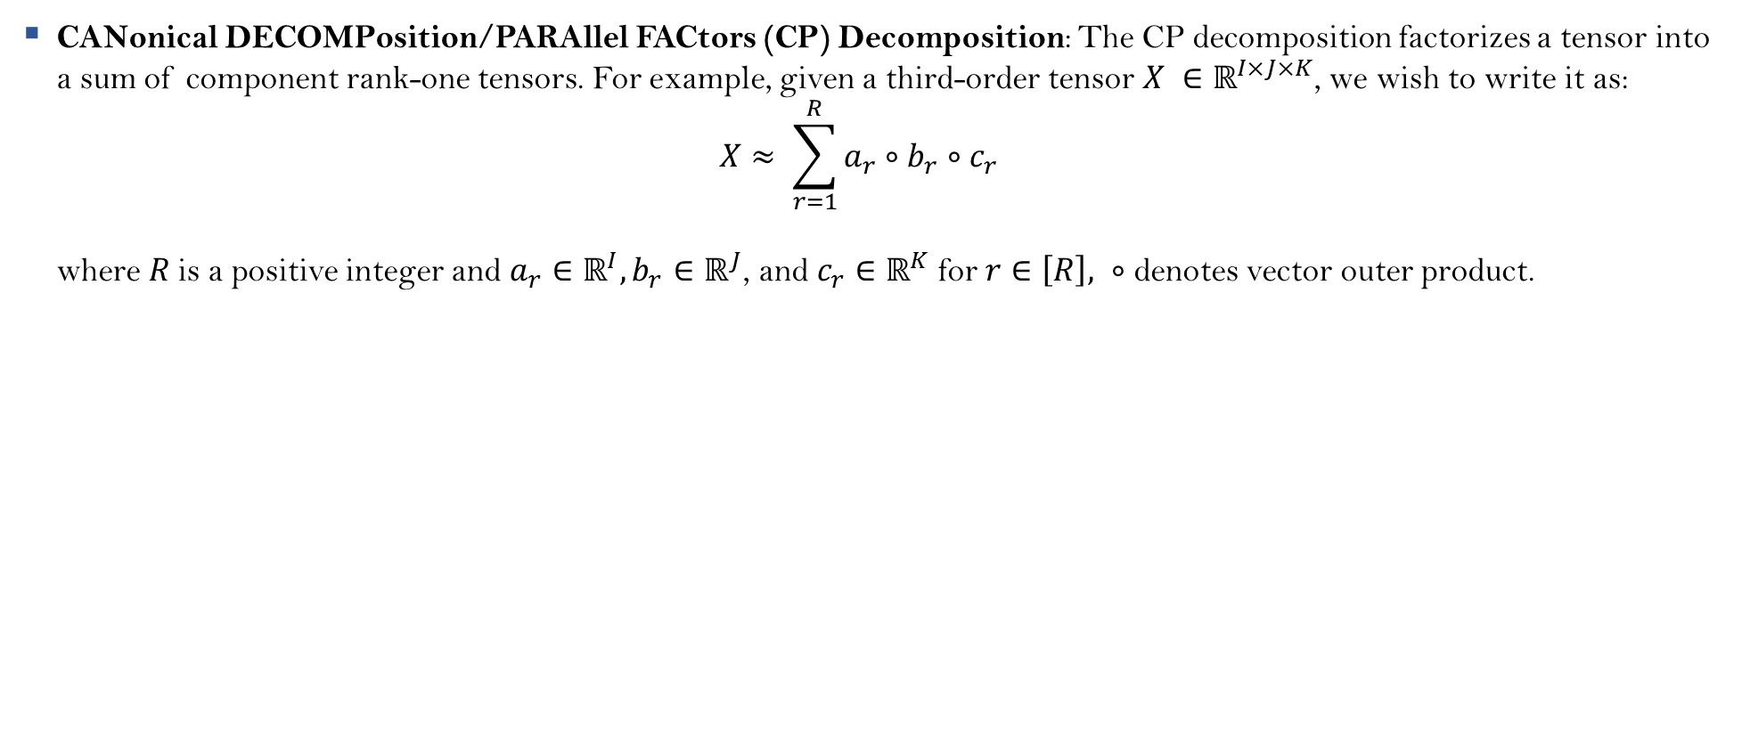
CANDECOMP/PARAFAC (CP)
CANonical DECOMPosition/PARAllel FACtors (CP) Decomposition: The CP decomposition factorizes a tensor into a sum of component rank-one tensors. For example, given a third-order tensor $X ∈ℝ^{I×J×K}$, we wish to write it as: $X≈ \sum_{r=1}^{R}{a_{r}∘b_{r}∘c_{r}}$ where $R$is a positive integer and $a_{r}∈ℝ^{I}, b_{r}∈ℝ^{J}$, and $c_{r}∈ℝ^{K}$for $r∈\left[R\right], ∘$ denotes vector outer product.
[Hitchcock; Carroll-Chang; Harshman; Kolda-Bader]

Slide 14
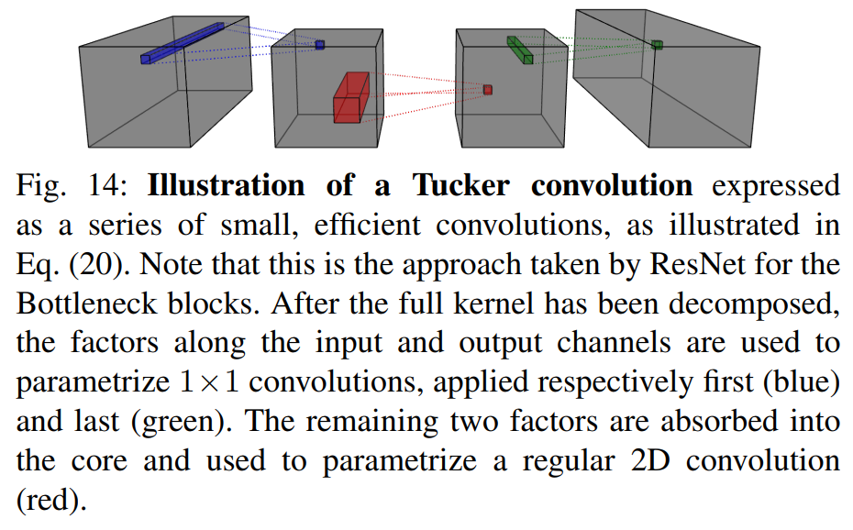
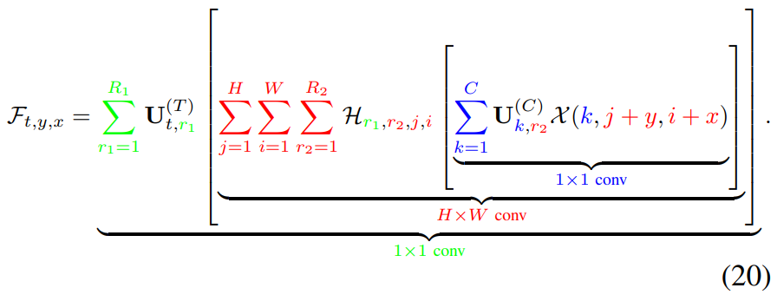
Tensorizing Convolution Operation
Tucker Convolution:
Uses Tucker Decomposition to approximate learnable separable filter bank
Employs series of convolutions
Filters don’t need to be separable now in the spatial dimensions
[Kim-Park-et al.; Panagakis-Koissafi-et al.]

Slide 15
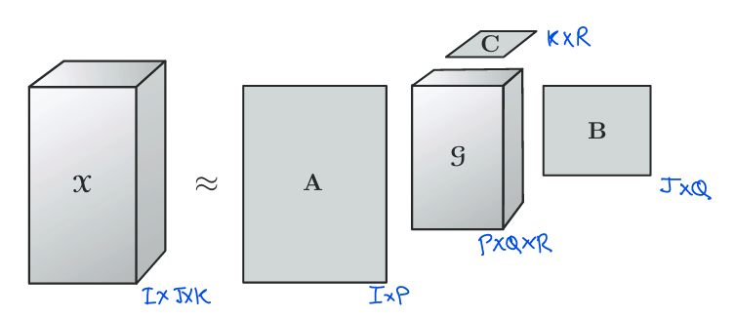
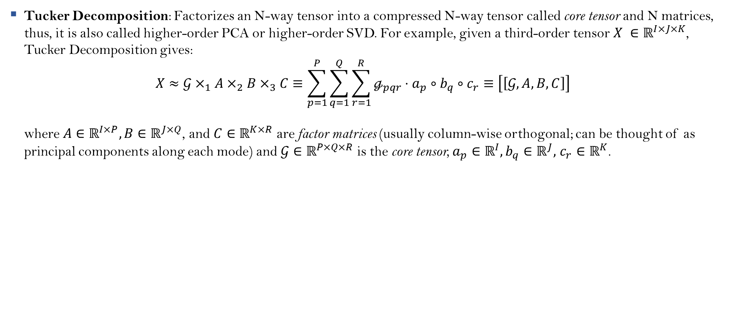
Tucker Decomposition
Tucker Decomposition: Factorizes an N-way tensor into a compressed N-way tensor called core tensor and N matrices, thus, it is also called higher-order PCA or higher-order SVD. For example, given a third-order tensor $X ∈ℝ^{I×J×K}$, Tucker Decomposition gives: $X≈𝒢×_{1}A×_{2}B×_{3}C≡\sum_{p=1}^{P}{\sum_{q=1}^{Q}{\sum_{r=1}^{R}{ℊ_{pqr}⋅a_{p}∘b_{q}∘c_{r}}}}≡\left[\left[𝒢, A, B, C\right]\right]$ where $A∈ℝ^{I×P}, B∈ℝ^{J×Q}$, and $C∈ℝ^{K×R}$ are factor matrices (usually column-wise orthogonal; can be thought of as principal components along each mode) and $𝒢∈ℝ^{P×Q×R}$ is the core tensor, $a_{p}∈ℝ^{I},b_{q}∈ℝ^{J},$ $c_{r}∈ℝ^{K}$.
[Tucker; Kolda-Bader]

Slide 16
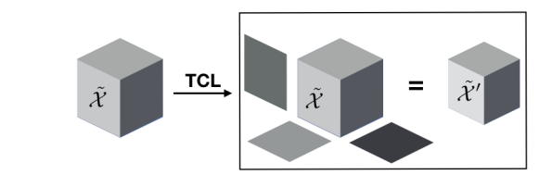
Tensorizing Contraction Layers
Now, output activation maps of Tensorized Convolutional Layers will be 4-D tensors
Naively flattening activation maps to pass on vectorized inputs to Fully-Connected Linear Layers destroys the multilinear structure
Hence, tensorize Contraction Layers (layers that transforms activation maps of convolutional layers to inputs of linear layers)
Proposition of a new layer called Tensor Contraction Layer (TCL):
Perform Tucker Decomposition of the input tensorized activation maps
Pass on the Tucker Core to the FC Connected Layers (Remember: Compressing Large Weight Matrices!)
Enforce Tucker Decomposition and learn Tucker Core and Factor Matrices while training
[Kossaifi-Khanna-et al.; Panagakis-Koissafi-et al.]

Slide 17
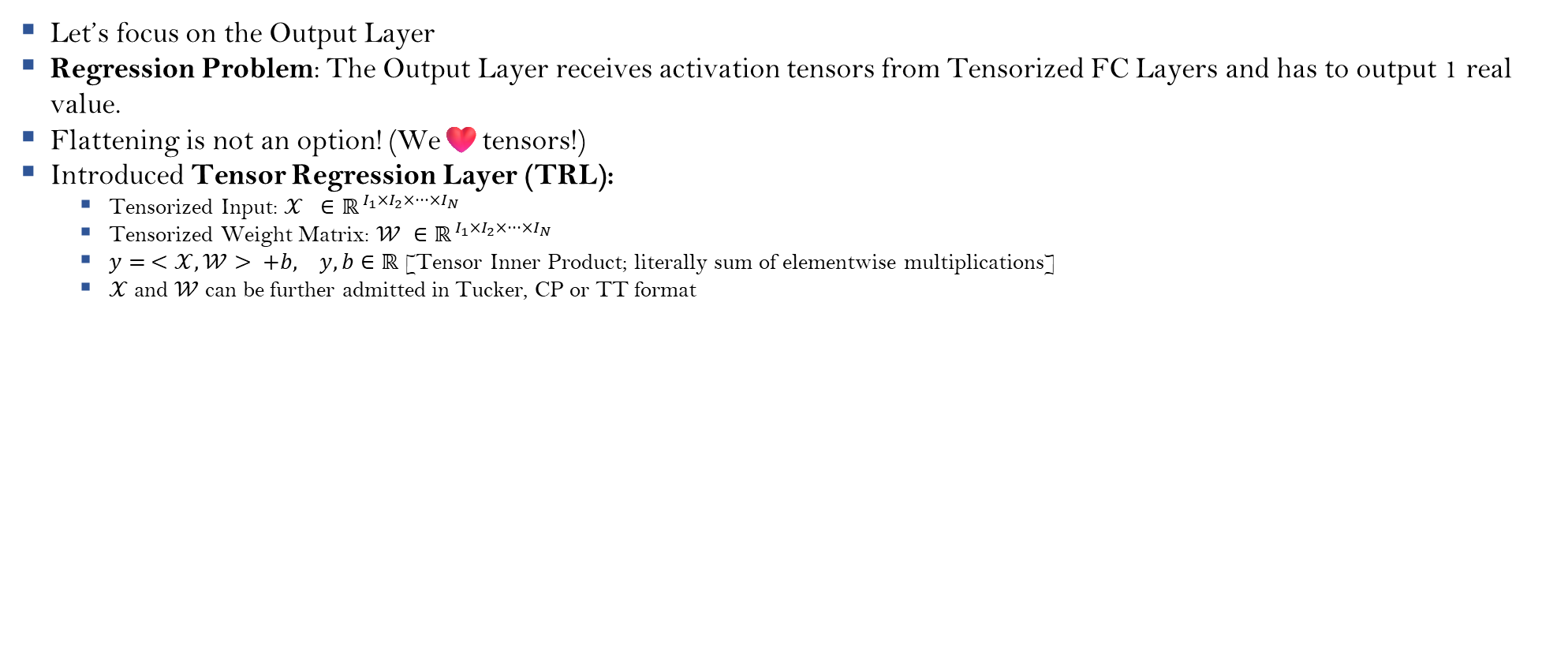
Tensorizing Regression Layer
Let’s focus on the Output Layer
Regression Problem: The Output Layer receives activation tensors from Tensorized FC Layers and has to output 1 real value.
Flattening is not an option! (We❤️tensors!)
Introduced Tensor Regression Layer (TRL):
Tensorized Input: $𝒳 ∈ℝ^{ I_{1}×I_{2}×···×I_{N} }$
Tensorized Weight Matrix: $𝒲 ∈ℝ^{ I_{1}×I_{2}×···×I_{N} }$
$y= <𝒳,𝒲> +b, y, b∈ℝ$ [Tensor Inner Product; literally sum of elementwise multiplications]
$𝒳$ and $𝒲$ can be further admitted in Tucker, CP or TT format
[Kossaifi-Lipton-et al.; Panagakis-Koissafi-et al.; tensor_regression_layer.ipynb]

Slide 18
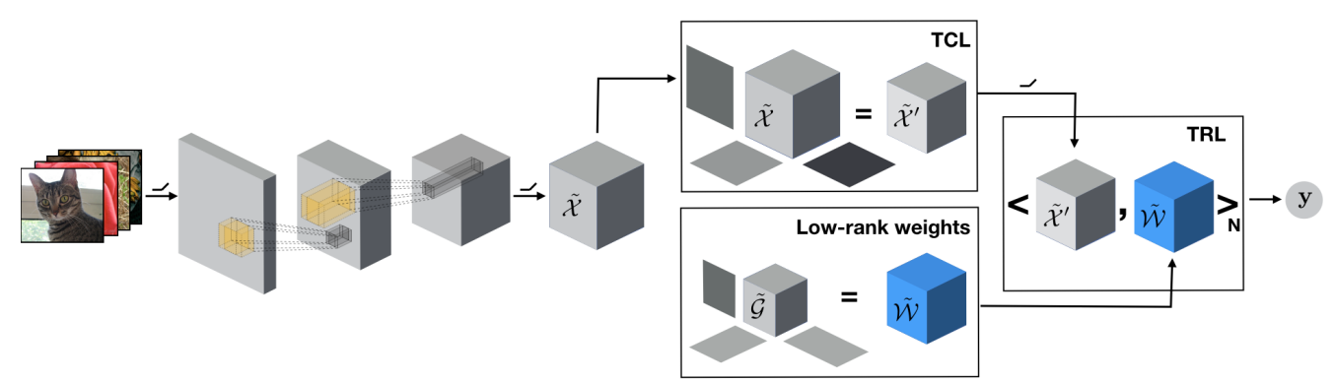
Compressing CNNs
[Panagakis-Koissafi-et al.]

Slide 19
Compressing RNNs, GRUs, LSTMs

Slide 20
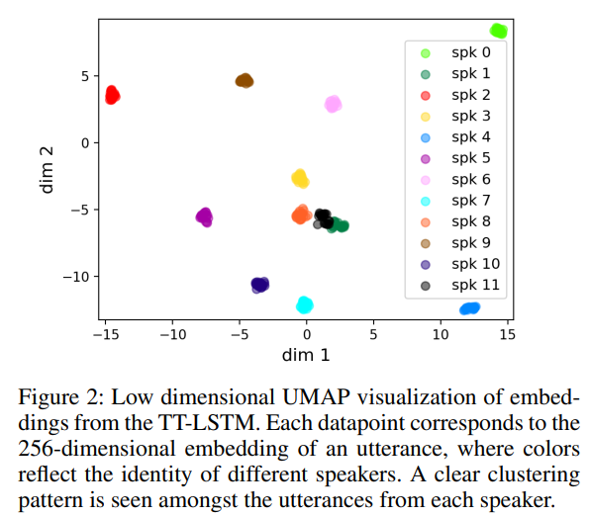
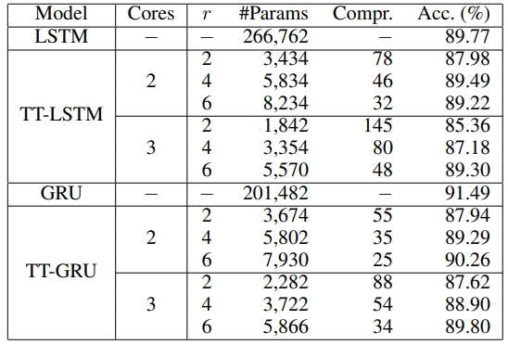
Compressing RNNs, GRUs and LSTMs
Remember: Compressing Large Weight Matrices!
Weights of RNNs, GRUs, LSTMs compressed using the same straight-forward methodology with additional Weight Sharing property natural to sequential models.
Use Tensor Train Decomposition
Even better approach:
Concatenate all weight matrices corresponding to every “cell” and “gate” and then compress to TT-format
This leads to even more compression as compared to compressing individual weight matrices
Observed implicit regularization because of TT-LSTM: Less overfitting, minimizing the issue of vanishing or exploding gradients
TT-LSTM also robust to changes in learning rate unlike Vanilla LSTM
[Onu-Miller-et al.; Novikov-Podoprikhin-et al.]

Slide 21
Compressing Transformers

Slide 22
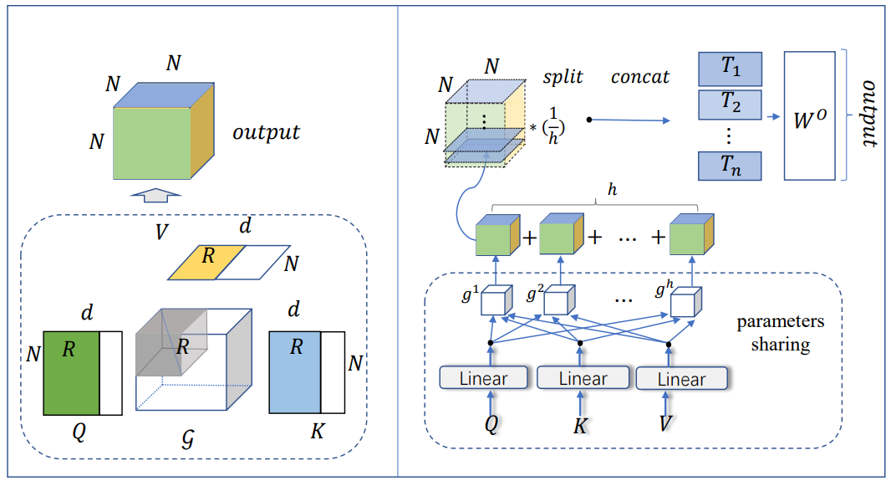
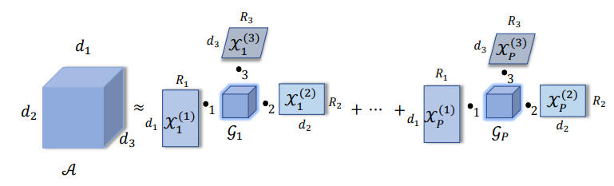
Compressing Transformers
Compression applied at multiple sections of the transformer:
Tensorizing Embedding Layers
Tensorizing Attention Heads
Tensorizing Embedding Layers:
Store Embedding Matrix in TT-format (Remember: Compressing Large Weight Matrices!)
Apart from compression, authors realized and proved that TT-embeddings are more expressive than vanilla matrix-based embeddings.
Also provided TT-embedding tensor initialization method and enforced TT-embedding structure in the model (just compressing pre-trained embedding matrix into TT-format does not exhibit better performance)
Tensorizing Attention Heads:
Proposed Multi-Linear Attention Module as a replacement of Self Attention
Performed Block Term Decomposition to obtain Attention Maps
[Hrinchuk-Khrulkov-et al.; Ma-Zhang-et al.; Rabanser-Shchur-G$\ddot{u}$nnemann; Kolda-Bader; Oseledets]

Slide 23
Thank You

Slide 24
Basic Preliminaries

Slide 25
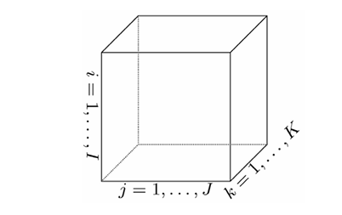
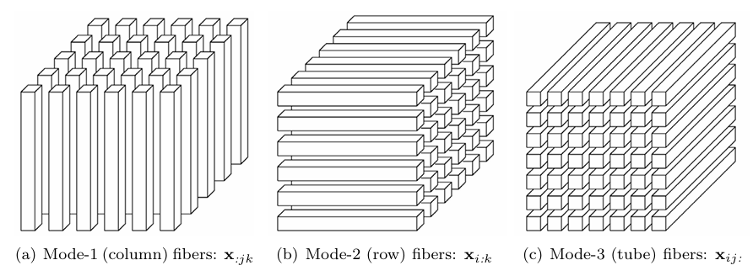
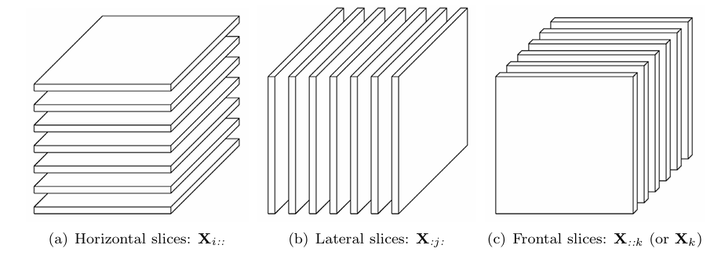
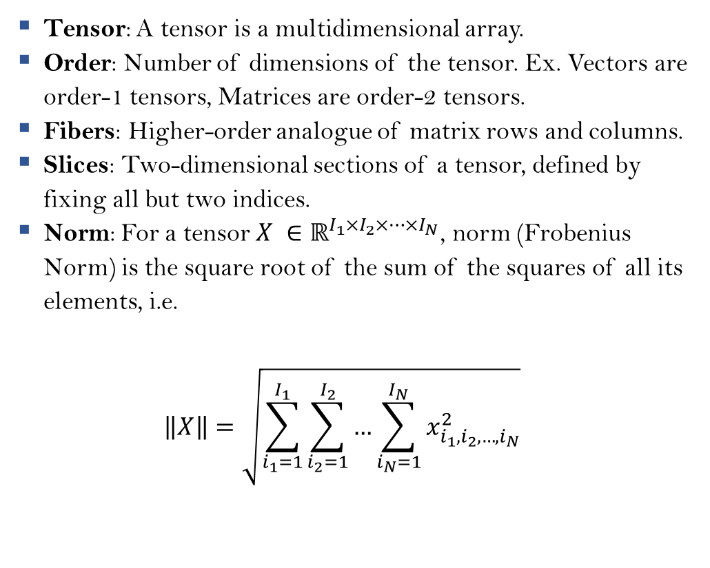
Definitions and Notations
Tensor: A tensor is a multidimensional array.
Order: Number of dimensions of the tensor. Ex. Vectors are order-1 tensors, Matrices are order-2 tensors.
Fibers: Higher-order analogue of matrix rows and columns.
Slices: Two-dimensional sections of a tensor, defined by fixing all but two indices.
Norm: For a tensor $X ∈ℝ^{I_{1}×I_{2}×…×I_{N}}$, norm (Frobenius Norm) is the square root of the sum of the squares of all its elements, i.e. $\left\|X\right\|=\sqrt{\sum_{i_{1}=1}^{I_{1}}{\sum_{i_{2}=1}^{I_{2}}{…\sum_{i_{N}=1}^{I_{N}}{x_{i_{1},i_{2},…, i_{N}}^{2}}}}}$
[Kolda-Bader]

Slide 26
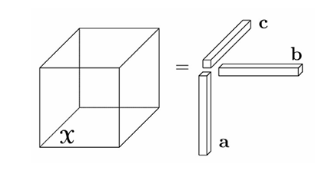
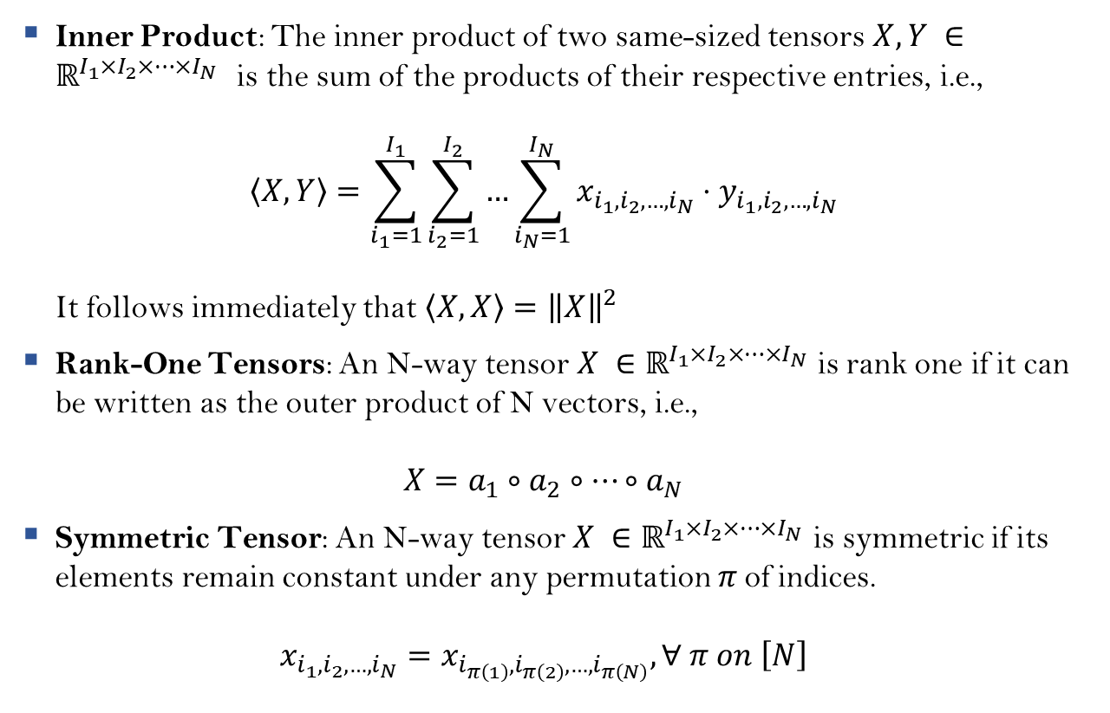
Definitions and Notations
Inner Product: The inner product of two same-sized tensors $X,Y ∈ℝ^{I_{1}×I_{2}×…×I_{N}}$ is the sum of the products of their respective entries, i.e., $\left\langle X,Y\right\rangle =\sum_{i_{1}=1}^{I_{1}}{\sum_{i_{2}=1}^{I_{2}}{…\sum_{i_{N}=1}^{I_{N}}{x_{i_{1},i_{2},…,i_{N}}⋅y_{i_{1}, i_{2},…,i_{N}}}}}$ It follows immediately that $\left\langle X,X\right\rangle ={\left\|X\right\|}^{2}$
Rank-One Tensors: An N-way tensor $X ∈ℝ^{I_{1}×I_{2}×…×I_{N}}$ is rank one if it can be written as the outer product of N vectors, i.e., $X=a_{1}∘a_{2}∘…∘a_{N}$
Symmetric Tensor: An N-way tensor $X ∈ℝ^{I_{1}×I_{2}×…×I_{N}}$ is symmetric if its elements remain constant under any permutation $π$of indices. $x_{i_{1},i_{2},…, i_{N}}=x_{i_{π\left(1\right)}, i_{π\left(2\right)}, …, i_{π\left(N\right)}}, ∀ π on \left[N\right]$
[Kolda-Bader]

Slide 27
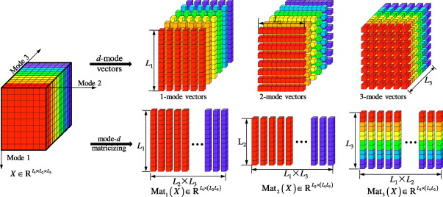

Matricization/Unfolding
Matricization: Matricization, also known as unfolding or flattening, is the process of reordering the elements of an N-way tensor into a matrix. The mode-n matricization of a tensor $X ∈ℝ^{I_{1}×I_{2}×…×I_{N}}$is denoted by $X_{\left(n\right)}$and arranges the mode-n fibers to be the columns of the resulting matrix.
[Kolda-Bader]

Slide 28
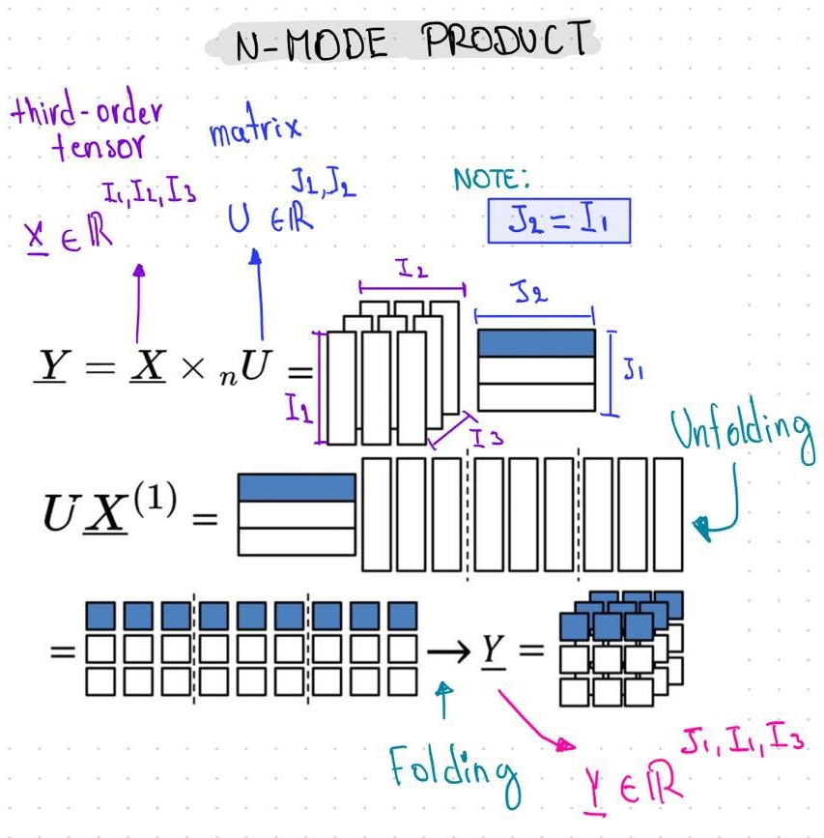
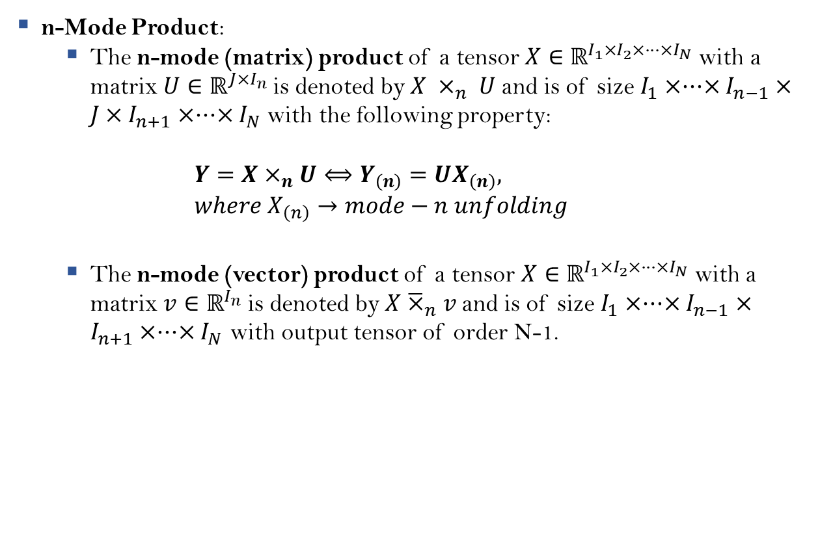
n-Mode Product
n-Mode Product:
The n-mode (matrix) product of a tensor $X∈ℝ^{I_{1}×I_{2}×···×I_{N}}$with a matrix $U∈ℝ^{J×I_{n}}$is denoted by $X ×_{n} U$and is of size $I_{1}×···×I_{n−1}×J×I_{n+1}×···×I_{N}$ with the following property: $Y=X×_{n}U⟺Y_{\left(n\right)}=UX_{\left(n\right)}, where X_{\left(n\right)}→mode−n unfolding$
The n-mode (vector) product of a tensor $X∈ℝ^{I_{1}×I_{2}×···×I_{N}}$with a matrix $v∈ℝ^{I_{n}}$is denoted by $X{\overline{×}}_{n}v$and is of size $I_{1}×···×I_{n−1}×I_{n+1}×···×I_{N}$ with output tensor of order N-1.
[Kolda-Bader]

Slide 29
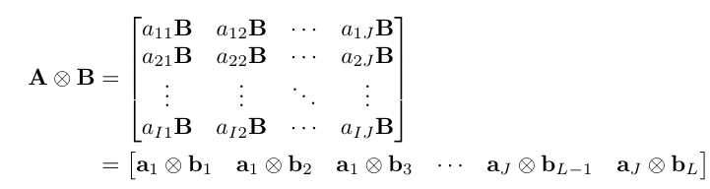
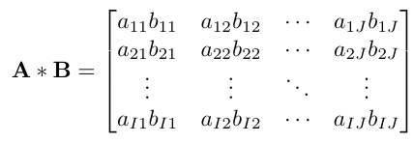
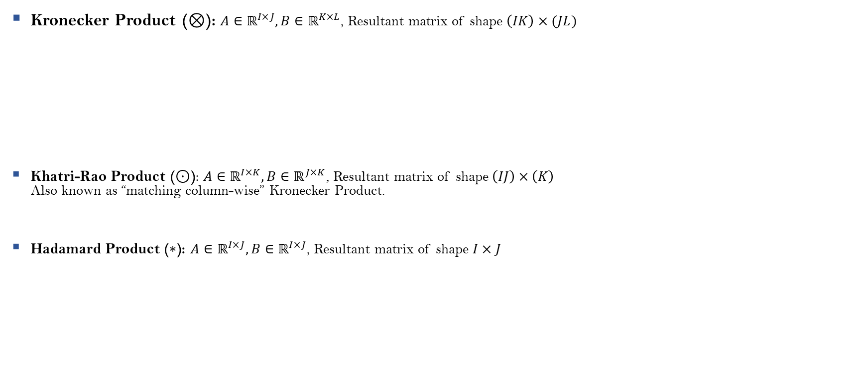
Some Common Tensor Products
Kronecker Product ($⊗$): $A∈ℝ^{I×J}, B∈ℝ^{K×L}$, Resultant matrix of shape $\left(IK\right)×(JL)$
Khatri-Rao Product ($⊙$): $A∈ℝ^{I×K}, B∈ℝ^{J×K}$, Resultant matrix of shape $\left(IJ\right)×\left(K\right)$ Also known as “matching column-wise” Kronecker Product.
Hadamard Product ($∗$): $A∈ℝ^{I×J}, B∈ℝ^{I×J}$, Resultant matrix of shape $I×J$
$$=[a_{1}∘b_{1}{ a}_{1}∘b_{2} a_{1}∘b_{3} …{ a}_{J}∘b_{L−1}{ a}_{J}∘b_{L}]$$
$$=[a_{1}∘b_{1}{ a}_{2}∘b_{2} a_{3}∘b_{3} …{ a}_{K}∘b_{K}]$$
[Kolda-Bader]

Slide 30
Tensor Decomposition

Slide 31
Introduction
Tensor Decomposition is an unsupervised learning technique for extracting relations, patterns and structure from data represented as tensors.
Tensor decompositions find use in signal processing, numerical linear algebra, computer vision, numerical analysis, data mining, graph analysis, neuroscience, and more.
More recent uses of Tensor Decomposition has been in learning latent variable models and parameter estimation, learning shallow neural networks, etc. pushing for faster and more reliable techniques for handling tensors.
Some well-known Tensor Decomposition techniques, namely:
CANDECOMP/PARAFAC (CP) Decomposition
Tucker Decomposition
Tensor-Train Decomposition
Block-Term Decomposition
Current research is on newer techniques of decomposition and methods to compute these decompositions motivated by domain knowledge and use-case.
[Kolda-Bader]

Slide 32
Tensor Decomposition Techniques

Slide 33
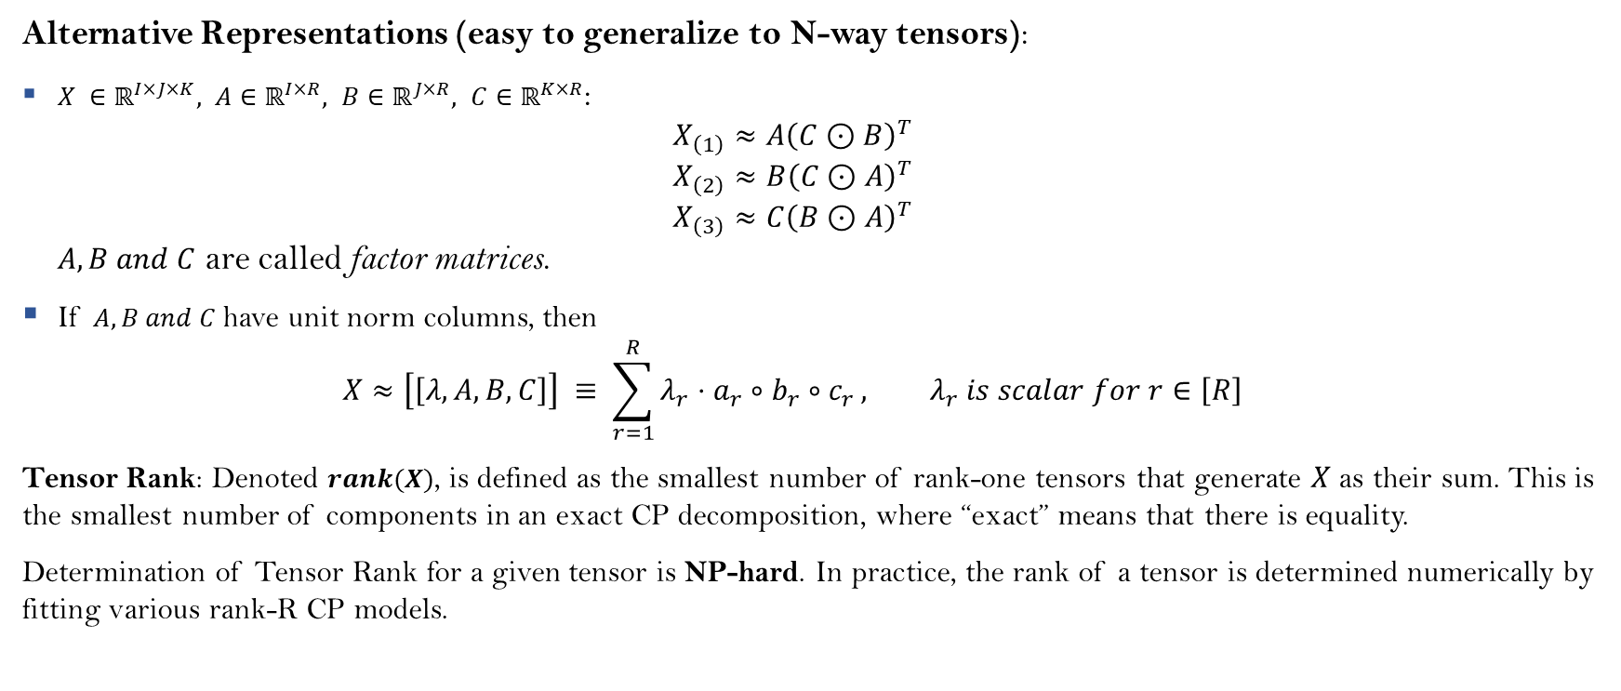
CANDECOMP/PARAFAC (CP)
Alternative Representations (easy to generalize to N-way tensors):
$X ∈ℝ^{I×J×K}, A∈ℝ^{I×R}, B∈ℝ^{J×R}, C∈ℝ^{K×R}$: $X_{\left(1\right)}≈A{\left(C⊙B\right)}^{T}$ $X_{\left(2\right)}≈B{\left(C⊙A\right)}^{T}$ $X_{\left(3\right)}≈C{\left(B⊙A\right)}^{T}$ $A, B and C$ are called factor matrices.
If $A, B and C$ have unit norm columns, then $X≈\left[\left[λ, A, B, C\right]\right] ≡ \sum_{r=1}^{R}{λ_{r}⋅a_{r}∘b_{r}∘c_{r}}, λ_{r} is scalar for r∈\left[R\right]$
Tensor Rank: Denoted $rank(X)$, is defined as the smallest number of rank-one tensors that generate $X$as their sum. This is the smallest number of components in an exact CP decomposition, where “exact” means that there is equality.
Determination of Tensor Rank for a given tensor is NP-hard. In practice, the rank of a tensor is determined numerically by fitting various rank-R CP models.
[Hitchcock; Carroll-Chang; Harshman; Kolda-Bader]

Slide 34
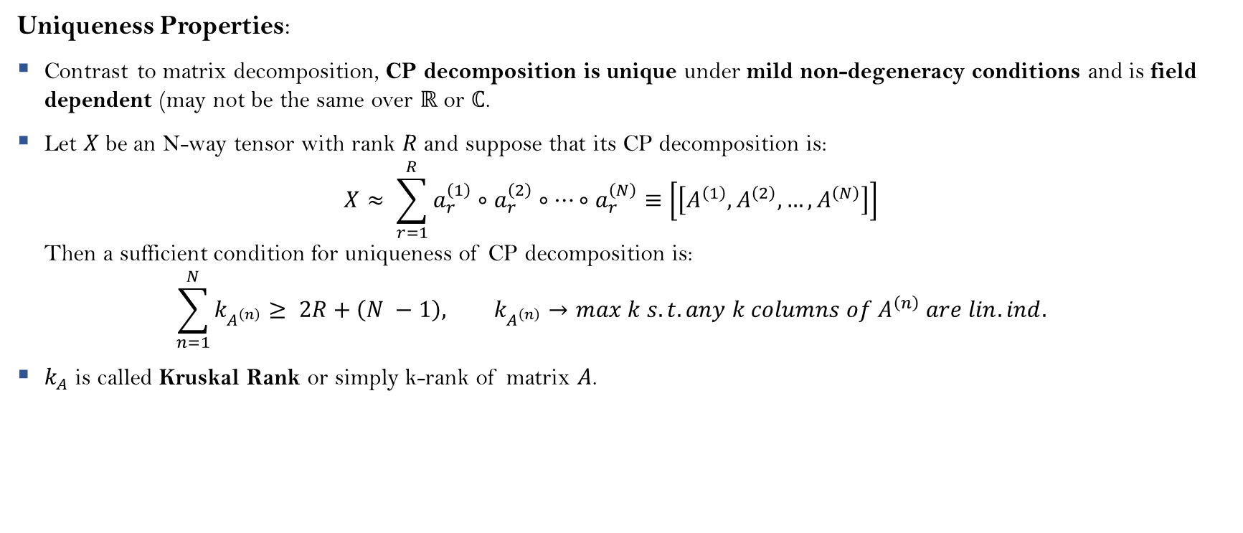
CANDECOMP/PARAFAC (CP)
Uniqueness Properties:
Contrast to matrix decomposition, CP decomposition is unique under mild non-degeneracy conditions and is field dependent (may not be the same over $ℝ$ or $ℂ$.
Let $X$be an N-way tensor with rank $R$and suppose that its CP decomposition is: $X≈ \sum_{r=1}^{R}{a_{r}^{\left(1\right)}∘a_{r}^{\left(2\right)}∘…∘a_{r}^{\left(N\right)}}≡\left[\left[A^{\left(1\right)}, A^{\left(2\right)},…, A^{\left(N\right)}\right]\right]$ Then a sufficient condition for uniqueness of CP decomposition is: $\sum_{n=1}^{N}{k_{A^{\left(n\right)}}}≥ 2R+\left(N −1\right), k_{A^{\left(n\right)}}→max k s.t. any k columns of A^{\left(n\right)} are lin. ind.$
$k_{A}$ is called Kruskal Rank or simply k-rank of matrix $A$.
[Kruskal; Hitchcock; Carroll-Chang; Harshman; Kolda-Bader]

Slide 35
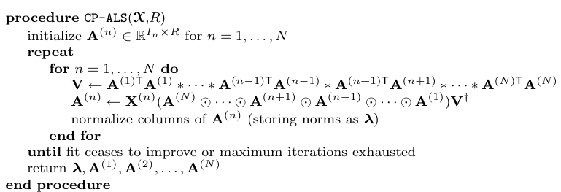
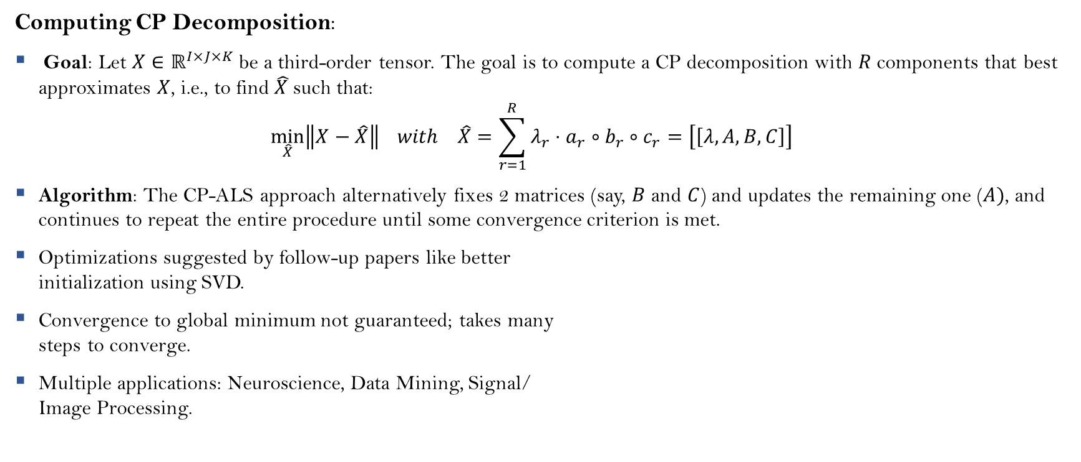
CANDECOMP/PARAFAC (CP)
Computing CP Decomposition:
Goal: Let $X∈ℝ^{I×J×K}$be a third-order tensor. The goal is to compute a CP decomposition with $R$components that best approximates $X$, i.e., to find $\hat{X }$such that: $\min_{\hat{X}}\left\|X−\hat{X}\right\| with \hat{X}=\sum_{r=1}^{R}{λ_{r}⋅a_{r}∘b_{r}∘c_{r}}=\left[\left[λ, A, B,C\right]\right]$
Algorithm: The CP-ALS approach alternatively fixes 2 matrices (say, $B$ and $C$) and updates the remaining one ($A)$, and continues to repeat the entire procedure until some convergence criterion is met.
Optimizations suggested by follow-up papers like better initialization using SVD.
Convergence to global minimum not guaranteed; takes many steps to converge.
Multiple applications: Neuroscience, Data Mining, Signal/ Image Processing.
[Hitchcock; Carroll-Chang; Harshman; Kolda-Bader]

Slide 36
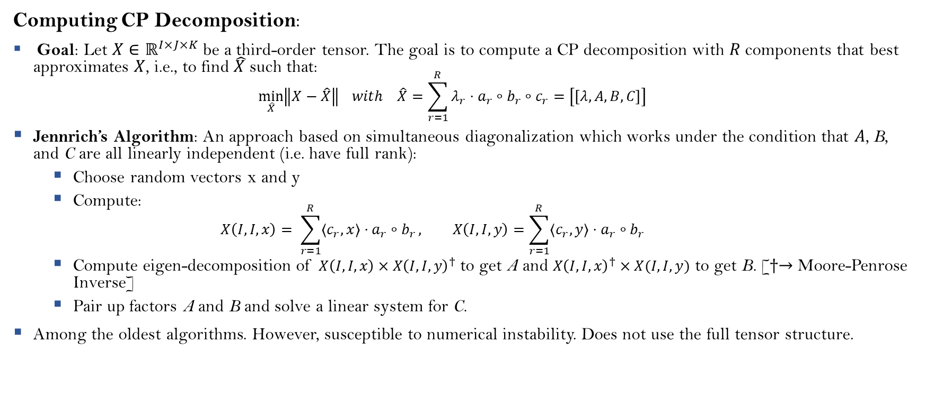
CANDECOMP/PARAFAC (CP)
Computing CP Decomposition:
Goal: Let $X∈ℝ^{I×J×K}$be a third-order tensor. The goal is to compute a CP decomposition with $R$components that best approximates $X$, i.e., to find $\hat{X }$such that: $\min_{\hat{X}}\left\|X−\hat{X}\right\| with \hat{X}=\sum_{r=1}^{R}{λ_{r}⋅a_{r}∘b_{r}∘c_{r}}=\left[\left[λ, A, B,C\right]\right]$
Jennrich’s Algorithm: An approach based on simultaneous diagonalization which works under the condition that $A$, B, and C are all linearly independent (i.e. have full rank):
Choose random vectors x and y
Compute: $X\left(I,I, x\right)= \sum_{r=1}^{R}{⟨c_{r}, x⟩⋅a_{r}∘b_{r}}, X\left(I,I,y\right)=\sum_{r=1}^{R}{⟨c_{r}, y⟩⋅a_{r}∘b_{r}}$
Compute eigen-decomposition of $X\left(I,I,x\right)×X{\left(I,I,y\right)}^{†}$ to get A and $X{\left(I,I,x\right)}^{†}×X(I,I, y)$ to get B. [$†→$ Moore-Penrose Inverse]
Pair up factors A and B and solve a linear system for C.
Among the oldest algorithms. However, susceptible to numerical instability. Does not use the full tensor structure.
[Harshman; Rabanser-Shchur-G$\ddot{u}$nnemann]

Slide 37
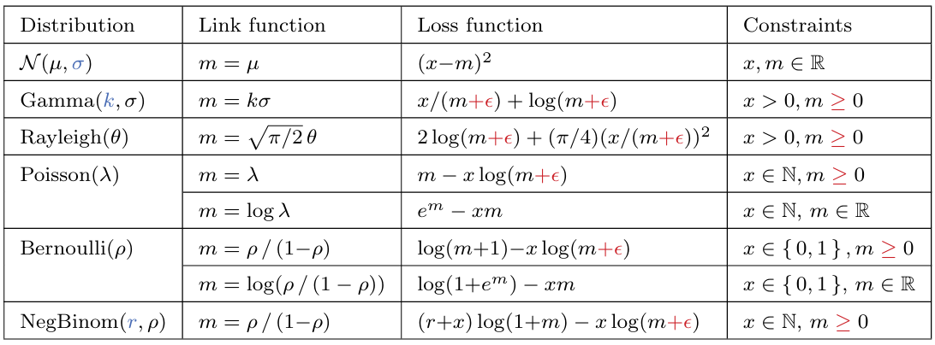
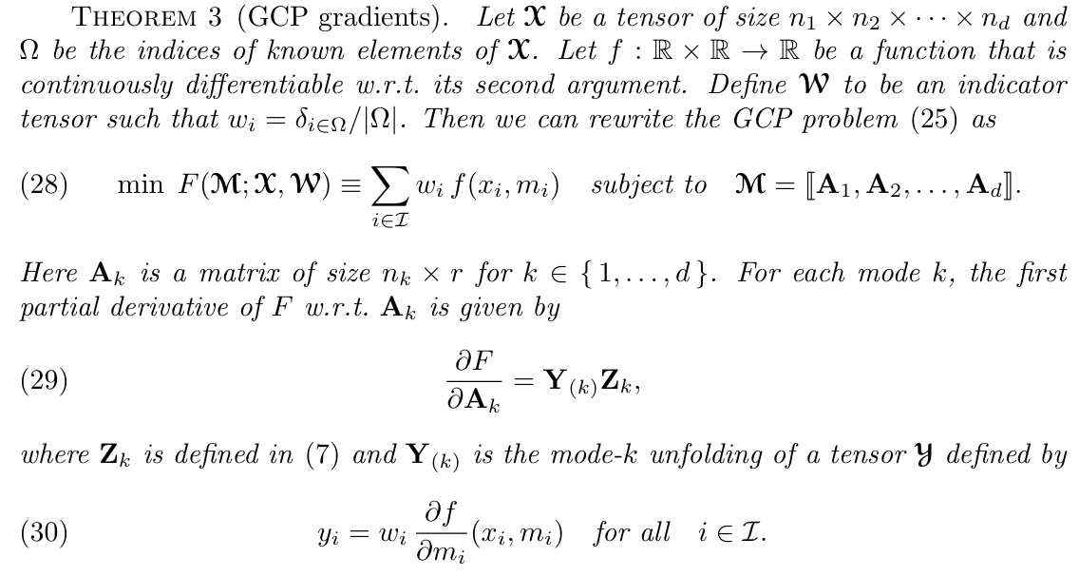
Generalized CANDECOMP/PARAFAC (GCP)
Generalized CP Decomposition: A generalized version of CP Decomposition where the main difference between GCP and standard CP is the choice of loss function for optimization.
Idea: Standard CP uses Frobenius Norm (squared loss) as a loss function in its objective. This, however, is useful when the data is normally distributed. GCP generalizes this notion of loss function for optimization based on distribution of data.
Algorithm:
The algorithm proposed for GCP is a common gradient descent-based approach to solving CP decomposition with the only change of loss function based on input data.
Shown that gradient computation for CP decomposition is essentially a multilinear operation famously known as MTTKRP (Matricized Tensor Times Khatri-Rao Product), which has been efficiently implemented.
Can handle missing entries (gradient computed only over observed data) and allows unsupervised pattern extraction over a variety of data types.
[Hong-Kolda-Duersch]

Slide 38
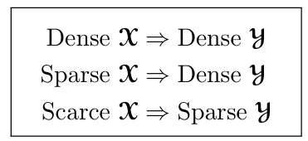
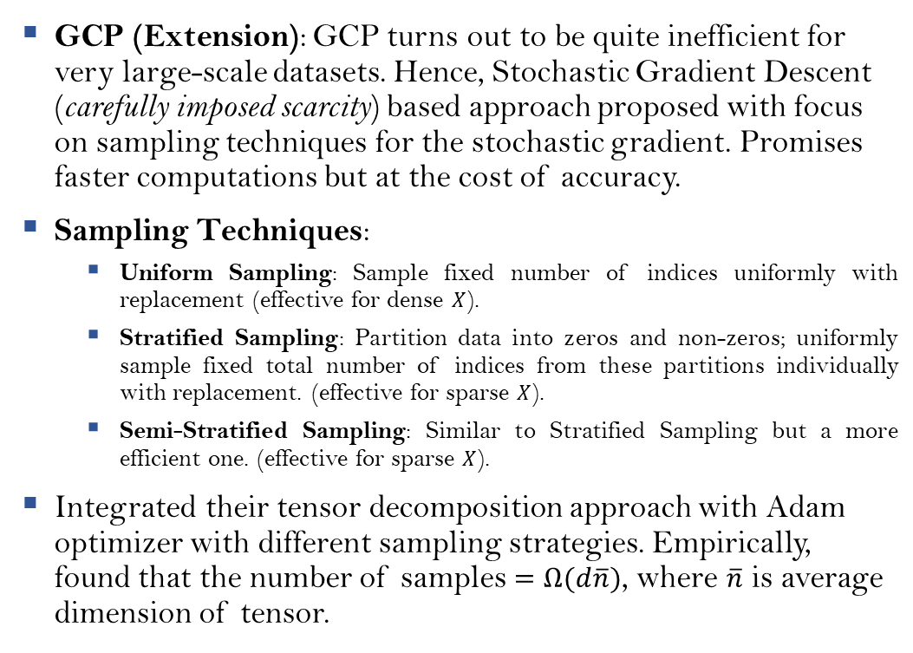

Generalized CANDECOMP/PARAFAC (GCP)
GCP (Extension): GCP turns out to be quite inefficient for very large-scale datasets. Hence, Stochastic Gradient Descent (carefully imposed scarcity) based approach proposed with focus on sampling techniques for the stochastic gradient. Promises faster computations but at the cost of accuracy.
Sampling Techniques:
Uniform Sampling: Sample fixed number of indices uniformly with replacement (effective for dense $X$).
Stratified Sampling: Partition data into zeros and non-zeros; uniformly sample fixed total number of indices from these partitions individually with replacement. (effective for sparse $X$).
Semi-Stratified Sampling: Similar to Stratified Sampling but a more efficient one. (effective for sparse $X$).
Integrated their tensor decomposition approach with Adam optimizer with different sampling strategies. Empirically, found that the number of samples $=Ω(d\overline{n})$, where $\overline{n}$ is average dimension of tensor.
Observed relation between input tensor $X$ and element-wise partial gradient tensor $Y$
Sparse $→$ many zeros
Scarce $→$missing data
[Hong-Kolda]

Slide 39

Tucker Decomposition
Tucker Decomposition: Factorizes an N-way tensor into a compressed N-way tensor called core tensor and N matrices, thus, it is also called higher-order PCA or higher-order SVD. For example, given a third-order tensor $X ∈ℝ^{I×J×K}$, Tucker Decomposition gives: $X≈𝒢×_{1}A×_{2}B×_{3}C≡\sum_{p=1}^{P}{\sum_{q=1}^{Q}{\sum_{r=1}^{R}{ℊ_{pqr}⋅a_{p}∘b_{q}∘c_{r}}}}≡\left[\left[𝒢, A, B, C\right]\right]$ where $A∈ℝ^{I×P}, B∈ℝ^{J×Q}$, and $C∈ℝ^{K×R}$ are factor matrices (usually column-wise orthogonal; can be thought of as principal components along each mode) and $𝒢∈ℝ^{P×Q×R}$ is the core tensor, $a_{p}∈ℝ^{I},b_{q}∈ℝ^{J},$ $c_{r}∈ℝ^{K}$.
[Tucker; Kolda-Bader]

Slide 40

Tucker Decomposition
Alternative Representations (easy to generalize to N-way tensors):
$X ∈ℝ^{I×J×K}, A∈ℝ^{I×P}, B∈ℝ^{J×Q}, C∈ℝ^{K×R}$: $X_{\left(1\right)}≈A{𝒢_{\left(1\right)}\left(C⊗B\right)}^{T}$ $X_{\left(2\right)}≈B{𝒢_{\left(2\right)}\left(C⊗A\right)}^{T}$ $X_{\left(3\right)}≈C{𝒢_{\left(3\right)}\left(B⊗A\right)}^{T}$
Two important variations (for order-3 tensors):
Tucker1 Decomposition sets two of the factor matrices to be Identity Matrix. Ex. 2nd and 3rd factor matrices are identity. Hence, problem reduced to standard 2-dimensional PCA. $X≈𝒢×_{1}A=\left[\left[𝒢, A, I, I\right]\right]≡X_{\left(1\right)}=A𝒢_{\left(1\right)}$
Tucker2 Decomposition sets one of the factor matrices to be Identity Matrix. Ex. 3rd factor matrix is identity. $X≈𝒢×_{1}A×_{2}B≡\left[\left[𝒢, A, B, I\right]\right]$
[Tucker; Kolda-Bader]

Slide 41

Tucker Decomposition
n-Rank: Let $X$be an N-way tensor of size $I_{1} ×I_{2} ×···×I_{N}$. Then the n-Rank of $X$, denoted $rank_{n}(X)$, is the column rank of $X_{\left(n\right)}$, mode-n unfolding of $X$.
Existence Properties: For a given tensor $X$, we can easily find an exact Tucker decomposition of rank $(R_{1},R_{2},…,R_{N})$*, where $R_{n} =rank_{n}(X)$. If, however, we compute a Tucker decomposition of rank $(R_{1},R_{2},…,R_{N})$, where $R_{n} <rank_{n}(X)$ for one or more n, then it will be necessarily inexact and more difficult to compute.
Uniqueness Properties: Tucker Decompositions are not unique. However, we can modify the core $𝒢$ without affecting the fit so long as we apply the inverse modification to the factor matrices. This ability enables to “simplify” the core tensor and improve uniqueness.
Goal: Let $X∈ℝ^{I×J×K}$be a third-order tensor. The goal is to compute a Tucker decomposition with given $\left(P, Q,R\right)$ that best approximates $X$, i.e., to find $\hat{X }$such that: $\min_{\hat{X}}\left\|X−\hat{X}\right\| with \hat{X}=\sum_{p=1}^{P}{\sum_{q=1}^{Q}{\sum_{r=1}^{R}{ℊ_{pqr}⋅a_{p}∘b_{q}∘c_{r}}}}≡\left[\left[𝒢, A, B, C\right]\right]$
*think of this as our input to Tucker Decomposition algorithm.
[Kruskal; Tucker; Kolda-Bader]

Slide 42



Tucker Decomposition
HOSVD (Higher Order SVD):
The basic idea is to find those components that best capture the variation in mode n, independent of the other modes.
When $R_{n} <rank_{n}\left(X\right),$ for one or more n, the decomposition is called the truncated HOSVD. Solution is not optimal in terms of giving the best fit as measured by the norm of the difference, but it is a good starting point for an iterative ALS algorithm.
HOOI (Higher Order Orthogonal Iteration):
Iterative ALS algorithm with the objective of minimizing the norm difference given $X∈ℝ^{I_{1}×I_{2}×…×I_{N}}$ and N n-ranks $\left(R_{1},R_{2},…, R_{N}\right)$.
[Tucker; Kolda-Bader]

Slide 43

Tensor-Train (TT) Decomposition
Tensor-Train Decomposition: Expresses $X$as a multilinear product of third-order tensors ${\left\{𝒢^{\left(n\right)}\right\}}_{n=1}^{N}$ according to: $X=𝒢^{\left(1\right)}×_{1}^{1}𝒢^{\left(2\right)}×_{2}^{1}…×_{N}^{1}𝒢^{\left(N\right)}$ where $𝒢^{\left(n\right)}∈ℝ^{r_{n−1}×I_{n}×r_{n}}$ is the $n^{th}$TT-core with $n∈\left[N\right]$ and $r_{0}=r_{N}=1$. ${\left\{r_{n}\right\}}_{n=1}^{N}$ are called TT-ranks.
Properties:
It is a space-saving representation of tensor decomposition, breaks the curse of dimensionality and has its own multilinear algebra.
Given an arbitrary tensor $X$, we can always find a set of TT-cores satisfying TT Decomposition with suitable TT-ranks. Besides, its TT-ranks can be effectively estimated in a stable way in contrast to the CP-rank determination.
See Appendix B for more detailed information
[Oseledets; Rabanser-Shchur-G$\ddot{u}$nnemann]

Slide 44


Block-Term Decomposition (BTD)
Block-Term Decomposition: Allows to represent $X$ as a sum of low multilinear-rank tensors:
$$X=\sum_{l=1}^{L}{\left[\left[𝒢_{l} , { \left\{U_{l}^{\left(n\right)}\right\}}_{n=1}^{N}\right]\right]}$$ where ${\left\{𝒢_{l}\right\}}_{l=1}^{L} with {𝒢_{l}∈ℝ}^{r_{1}×r_{2}×…×r_{N}}$ is a set of core tensors (analogous to Tucker Decomposition) and $U^{(n)}=\left[U_{1}^{\left(n\right)},U_{2}^{\left(n\right)}, …, U_{L}^{\left(n\right)}\right]$ is the $n^{th}$ tensor factor with $U_{l}^{\left(n\right)}∈ℝ^{I_{n}×r_{n}}$, $r_{n}≤l_{n}∀ l,n$.
Properties:
Considered as a combination of CP [L low rank components] and Tucker [($r_{1}, r_{2},…, r_{N})$-rank cores and factor matrices for each term].
When these blocks are rank-1 tensors (i.e., $r_{n}=1∀ n$), it boils down to CP. When it has only one block (i.e., $L= 1$), BTD becomes the standard Tucker decomposition.
Like CP, BTD is essentially unique. The common approach to find BTD is also based on the ALS technique.
BTD for order-3 tensor
[Rabanser-Shchur-G$\ddot{u}$nnemann; Kolda-Bader]

Slide 45


Other Decomposition Techniques
INDSCAL: Individual differences in scaling (INDSCAL) is a special case of CP for three-way tensors that are symmetric in two modes, represented as: $X≈ \sum_{r=1}^{R}{a_{r}∘a_{r}∘c_{r}}≡\left[\left[A, A, C\right]\right]$
PARAFAC2: A variant of CP that can be applied to a collection of matrices that each have the same number of columns but a different number of rows. Essentially, PARAFAC2 relaxes some of CP’s constraints. It is not unique without additional constraints.
[Carroll-Chang; Harshman; Kolda-Bader]

Slide 46


Other Decomposition Techniques
CANDELINC: CANonical DEcomposition with LInear Constraints is CP with linear constraints on one or more of the factor matrices. Constraints are added as a consequence of domain knowledge. The model is: $X≈ \left[\left[φ_{A}\hat{A},φ_{B}\hat{B},,φ_{C}\hat{C},\right]\right], A=φ_{A}\hat{A},{B= φ}_{B}\hat{B},{C=φ}_{C}\hat{C}$ where$φ_{A},φ_{B},φ_{C}$ are constraint matrices and $\hat{A}, \hat{B}, \hat{C}$ are constraint solutions.
DEDICOM: DEDICOM (DEcomposition into DIrectional COMponents) deals with decompositions of data with asymmetric relationships between data objects.
[Carroll-Kruskal-Pruzansky; Harshman; Kolda-Bader]

Slide 47
Application of Tensor Methods

Slide 48

Latent Variable Models – Parameter Estimation
Application:
Expressing latent variable models (including Gaussian Mixture Models (GMMs), Hidden Markov Models (HMMs), Latent Dirichlet Allocation (LDA), topic modelling) as tensors and their decompositions reveal parameters to be estimated with strong guarantees.
Also used in guaranteed community detection in graphs (both overlapping and non-overlapping communities).
Proposed statistically and computationally effective tensor decomposition method for solving the problem.
Idea:
Higher order moments (at least order-3 or grater tensors) are rich source of information between the observed data and their “appropriate” CP decompositions (agreeing certain non-degeneracy conditions) yield parameters of the latent variable model. Recovering the parameters thus reduces to the problem of finding a certain orthogonal spectral decomposition (called Tensor Power Iteration method, analogous to Matrix Power Iteration) of a symmetric tensor (higher order moment tensor). $X= \sum_{r=1}^{R}{λ_{r}⋅v_{r}∘v_{r}∘v_{r}}, {X→Moment Tensor v}_{r}→Parameters of LVM and "eigenvectors" of X, v_{i}⊥v_{j} ∀i≠j$
Further adapted to non-orthogonal CP decomposition (with some soft-orthogonality constraints called incoherence), asymmetric tensors and overcomplete settings (when the CP-rank of tensor k is greater than dimension of data). This newer version was an Alternating Rank-1 Update Algorithm, a generalized and finer version of Tensor Power Iteration Method.
[Anandkumar-Ge-Hsu-Kakade-et al.]

Slide 49


Latent Variable Models – Parameter Estimation
Algorithm:
Input: Asymmetric Orthogonally Indecomposable Order-3 Tensor of rank k
Algorithm Initialization: 2 approaches (SVD with stronger guarantees but more compute)
Tensor Power Iteration: The core algorithm Alternating Rank-1 Update method for computing eigenpairs.
Full algorithm in Appendix A
[Anandkumar-Ge-Janzamin]

Slide 50

Discriminative Learning – Neural Networks
Application and Idea:
Used previously proposed spectral tensor decomposition methods for learning discriminative features extracted from unlabelled data which, later combined with labelled data, can be used for supervised learning.
Very useful in learning richer class of generative models of the input for discriminative learning because of the higher order score-functions (higher order derivatives (at least 3 or greater) of input probability density distribution).
Algorithm proposed is similar to Alternating Rank-1 Updates (for symmetric case) or Tensor Power Iteration. Generalized their approach to non-orthogonal decomposition and overcomplete settings.
Proved that higher order score functions (a higher order analogue of Stein’s Identity) yields derivatives of the label function.
[Anandkumar-Sedghi-Janzamin]

Slide 51



Discriminative Learning – Neural Networks
Application and Idea:
Extended previous application to learning parameters of 2-layer neural networks with statistical and computational guarantees, if given some knowledge about the distribution of input features. Novel idea for resolving non-convexity in learning the parameters.
Proposed NN-LIFT (Neural Network LearnIng using Feature Tensors) algorithm for guaranteed training neural networks which uses spectral tensor decompositions in its main step (learning the weights of layer 1).
Claimed to have bounded approximation error and estimation error for their methods in realizable and non-realizable settings.
Tensor Decomposition Procedure:
Input: Symmetric Cross-Moment order-3 tensor between Score Functions of input and labels.
Intermediate Tensorization Step (for overcomplete settings, i.e. when number of neurons in hidden neurons is more than feature dimension of the input/output).
Whitening: Orthogonalize components of input tensor before naïve Tensor Power Iteration method. Also performs dimensionality reduction in some sense.
Tensor Decomposition Sub-Procedure
[Anandkumar-Sedghi-Janzamin]

Slide 52

Deep Neural Networks - Reinforcement Learning
Application:
Tensor decompositions have also been used to compress deep neural network architectures like CNNs and RNNs.
Unified frameworks have been proposed for compressing both the Convolutional Layers and FCN layers of a CNN (Tucker Decomposition).
RNNs have been compressed via Tensor-Train Decomposition and most promising, Block-Term Decomposition, boasting better accuracy as compared original RNN with fewer parameters.
For standard MLPs, claim is that shallow networks can be learnt via rank-1 CP decomposition and deeper NNs can be learnt via hierarchical Tucker Decomposition, which are deemed to be exponentially more expressive than CP model.
Tensor Completion tasks (similar to recommender systems) concerning Transition matrix in Markov Decision Processes (MDPs) of RL have also used Tensor Decompositions of available transition probabilities to estimate unknown transition probabilities.
Representation of State and Action space of RL agents as tensors for more expressivity has also been explored.
Compression of FCN layers of CNN
[Kossaifi-et al.; Awasthi-Tang-Vijayaraghavan; Cohen-et al.; Sun-Hao-Li]

Slide 53
Appendix A

Slide 54



Alternating Rank-1 Updates Algorithm
[Anandkumar-Ge-Janzamin]

Slide 55
Appendix B

Slide 56

Tensor-Train Decomposition (TT)
Representation: Let $𝒳{∈ℝ}^{n_{1}×n_{2}×…×n_{d}}$ be an order-d tensor. Then, exact TT-decomposition yields the following representation of elements of the tensor: $𝒳\left(i_{1}, i_{2},…, i_{d}\right)=𝒢_{1}\left(i_{1}\right)×𝒢_{2}\left(i_{2}\right)×…×𝒢_{d}\left(i_{d}\right)$ where $𝒢_{k}∈ℝ^{r_{k−1}{×r}_{k}×n_{k}}, 𝒢_{k}\left(i_{k}\right)$ is a matrix of shape $r_{k−1}×r_{k}$ with the constraint that $r_{0}=r_{d}=1$.
The ranks $r_{k}, k∈\left\{0, 1,2, …, d\right\}$ are called TT-ranks or compression ranks.
[Oseledets]

Slide 57


Tensor-Train Decomposition (TT)
Representation: Using Tensor Networks
[Miles Stoudenmire (YT) - IPAM]

Slide 58

Tensor-Train Decomposition (TT)
Unfolding matrix: Unfolding matrix $X_{k}$ of a tensor $𝒳{∈ℝ}^{n_{1}×n_{2}×…×n_{d}}$ is given by: $X_{k}=reshape\left(𝒳, \prod_{i=1}^{k}{n_{i} }, \prod_{i=k+1}^{d}{n_{i}}\right), k∈\left\{0, 1, 2, …, d\right\}$
Existence Properties: There exists TT-decomposition of arbitrary $𝒳$ with TT-ranks $r_{k}≤{rank(X}_{k})$.
Algorithm: TT-SVD (“workhorse” algorithm – exact decomposition (up to numerical instability))
TT-Decomposition is computed by performing $d$ sequential SVDs of auxiliary matrices.
For the approximate case, when unfolding matrices are of low-rank approximately, i.e., $X_{k}=R_{k}+E_{k}, rank\left(R_{k}\right)=r_{k}, {‖E}_{k}{\left.​\right\|}_{F}=ε_{k}$ then TT-SVD computes tensor $𝒴$ in TT-format with TT-ranks $r_{k}$ such that: ${\left\|𝒳 −𝒴\right\|}_{F}≤\sqrt{\sum_{k=1}^{d−1}{ε_{k}^{2}}}$
Given a tensor $𝒳$ and rank bounds $r_{k}$, the best approximation to $𝒳$ in the Frobenius norm with TT-ranks bounded by $r_{k}$ always exists (say, $𝒳_{best}$), and the TT-approximation $𝒴$ computed by the TT-SVD algorithm is quasi-optimal: ${\left\|𝒳−𝒴\right\|}_{F}≤\sqrt{d−1}×{\left\|𝒳−𝒳_{best}\right\|}_{F}$
[Oseledets]

Slide 59

More on TT Decomposition
Time Complexities:
Addition (with TT-rounding): $O\left(dNr^{3}\right)$
Matrix-by-vector multiplication: $O\left(dN^{2}r^{4}\right)$
Hadamard Product: $O\left(dNr^{4}\right)$
TT-rounding: $O\left(dNr^{6}\right)$
[Li-Wang-Yau-Zhang; Oseledets]

Slide 60



TT – SVD
For a given matrix $A$, its $δ$-rank is defined as: $\min_{B} (rank\left(B\right)) s.t.{\left\|A−B\right\|}_{F}≤δ$
[Oseledets]

Slide 61
TT – SVD
[Oseledets]

Slide 62

TT – SVD
[Liu-Yang-Wang-Zhao-Zhang ]

Slide 63





TT – TSVD
TT-TSVD: A multi-modal TT-decomposition. Possesses both advantages of TT-decomposition and TSVD. It reduces data dimensionality with high-efficiency and keeps correlations between modes.
TSVD: Given a tensor $T∈ℝ^{O_{1}×O_{2}×···×O_{N} ×P_{1}×P_{2}×···×P_{M} }$, the TSVD of T is: $T = U ∗_{N} D ∗_{M} V^{T}$ where $∗_{I}$ represents Einstein Product of $I$ dimensions, $U∈ℝ^{O_{1}×O_{2}×···×O_{N} ×O_{1}×O_{2}×···×O_{N} }$and $V∈ℝ^{P_{1}×P_{2}×···×P_{M} ×P_{1}×P_{2}×···×P_{M} }$are orthogonal tensors and $D∈ℝ^{O_{1}×O_{2}×···×O_{N} ×P_{1}×P_{2}×···×P_{M} }$is a diagonal tensor.
[Liu-Yang-Wang-Zhao-Zhang]

Slide 64


TT – TSVD
[Liu-Yang-Wang-Zhao-Zhang]

